Slide 1


Bse3214: Cloud Computing and Big Data
Understanding data management in the digital age
Economics of Cloud Computing

Slide 2
In last Lecture
SaaS Interaction Dynamics and Software Stack Control
SaaS Benefits, Issues and Concerns, Suitability, and Recommendations
PaaS Benefits, Issues and Concerns, Suitability, and Recommendations

Slide 3
In this Lecture
Cloud Economics
SWOT Analysis and Value Proposition
General Cloud Computing Risks
Cloud Computing Cost Analysis
Selecting an IaaS Provider
Cloud Standards and Inter cloud Interoperability
Recommendations for Successful Cloud Migration

Slide 4
Cloud economics
Cloud economics is the process of examining the financial and functional impact of cloud computing on an organization.
A cloud economics analysis weighs financial factors such as return on investment (ROI), legacy hardware investment, and the total cost of ownership (TCO) for the cloud versus on-premises data centers.
A cloud economist is someone in an organization that looks at the tangible and theoretical benefits of cloud infrastructure.
Understanding cloud economics is essential for organizations.
Notes:
Leaders assess the critical elements involved in a potential cloud migration.
Cloud economics studies the financial impact of cloud computing, including elements such as : legacy hardware investments,
monthly cloud service budgeting,
and projected savings due to better collaboration and technical innovations,
to help an organization better assess its situation.
What is a cloud economist?
A cloud economist is someone in an organization that looks at the tangible and theoretical benefits of cloud infrastructure.
Their scope of examination ranges from practical cost savings via hardware reduction to projected savings from accelerated workflows and increased collaboration.

Slide 5
What is cloud economics analysis
A cloud economics analysis should answer the following questions:
What do internal operations teams need?
What do customers need?
Do the company’s products or services require IT support for core functionality?
What cloud-based tools do employees use?
What compliance and regulatory factors apply?

Slide 6
Why do companies move to the cloud
Scalability: Easy to scale resources in a cloud environment.
Improved collaboration: Cloud infrastructure better supports data integration, remote access, and other methods of flexibly syncing users.
Flexibility: The scalability of the cloud allows it to handle sudden increases in demand efficiently.
IT productivity: Cloud services shift regular server maintenance to the provider, alleviating the workload of essential IT tasks.
Increased security: Cloud infrastructure offers many data security improvements.
Better disaster recovery: Cloud providers business models are built around data availability and often offer more options and faster execution when it comes to disaster recovery.
Notes:
Scalability:
In a data center, resource growth is dependent on purchasing and integrating new hardware.
When demand spikes, scaling to meet that demand can be a costly and slow process.
In a cloud environment, resource usage scales as needed based on configurations and SLAs, making it easier to maintain stability and functionality as your needs expand.
Businesses can easily scale cloud resources up or down based on demand, avoiding over-provisioning of hardware.
Improved collaboration:
By granting easier access to tools, data, and lines of communication, cloud computing can significantly
increase staff collaboration and accelerate data sharing among departments.
Flexibility: The scalability of the cloud allows it to handle sudden increases in demand efficiently.
For instance, if an app experiences a surge in download requests due to a viral moment, local data centers may struggle to upgrade in time.
The cloud's pay-as-you-go model enables it to manage these spikes without requiring significant long-term investments.
IT productivity:
This transition enables staff to focus on more important projects that enhance the organization, such as product development.
Increased security:
From a practical perspective, public cloud providers focus their entire business models on ensuring security for their customers, so their investments in and efforts to maintain security will generally outdo those of individual IT departments.
Big cloud providers have more tiers of defense, larger investments in the latest security innovations, a better ability to hire scarce security talent, and faster compliance with the latest regulatory rules. In addition, centralized administration executes all patching and security updates for infrastructure and applications quickly and with minimal or no downtime.
Better disaster recovery:
Greater levels of redundancy, fast failover, and anywhere, anytime access ensure users can recover data, even in the event of a natural disaster.

Slide 7
Economic benefits of the cloud
Reduced TCO: With an on-premises configuration, an organization must budget for all stages of a hardware cycle
Save on intangibles: Cloud alleviates IT staff from maintenance tasks.
Scale as needed: Cloud providers scale on demand with a pay-as-you-go pricing model
Notes:
Reduced TCO: With an on-premises configuration, an organization must budget for all stages of a hardware cycle, from initial acquisition to maintenance costs and configuration time. In a cloud environment, the provider handles data center needs. The provider’s staff takes care of replacements and repairs, relieving cloud customers of the need for capital investments and ongoing licensing and maintenance costs.
Save on intangibles: If your IT staff aren’t burdened by maintenance tasks, such as troubleshooting a problematic server, where could they spend that time and effort? Moving to the cloud frees them up so they can further IT innovation for the organization and drive improvements that create efficiencies and stability.
Scale as needed:
When working with an on-premises data center, hardware plans must account for the maximum possible resource usage.
For example, if an upcoming launch is expected to drive traffic, then IT must scale to that volume with additional safety-net coverage.
However, if the app’s launch drives less than the anticipated traffic, all that overhead will be wasted. Cloud providers scale on demand with a pay-as-you-go pricing model

Slide 8
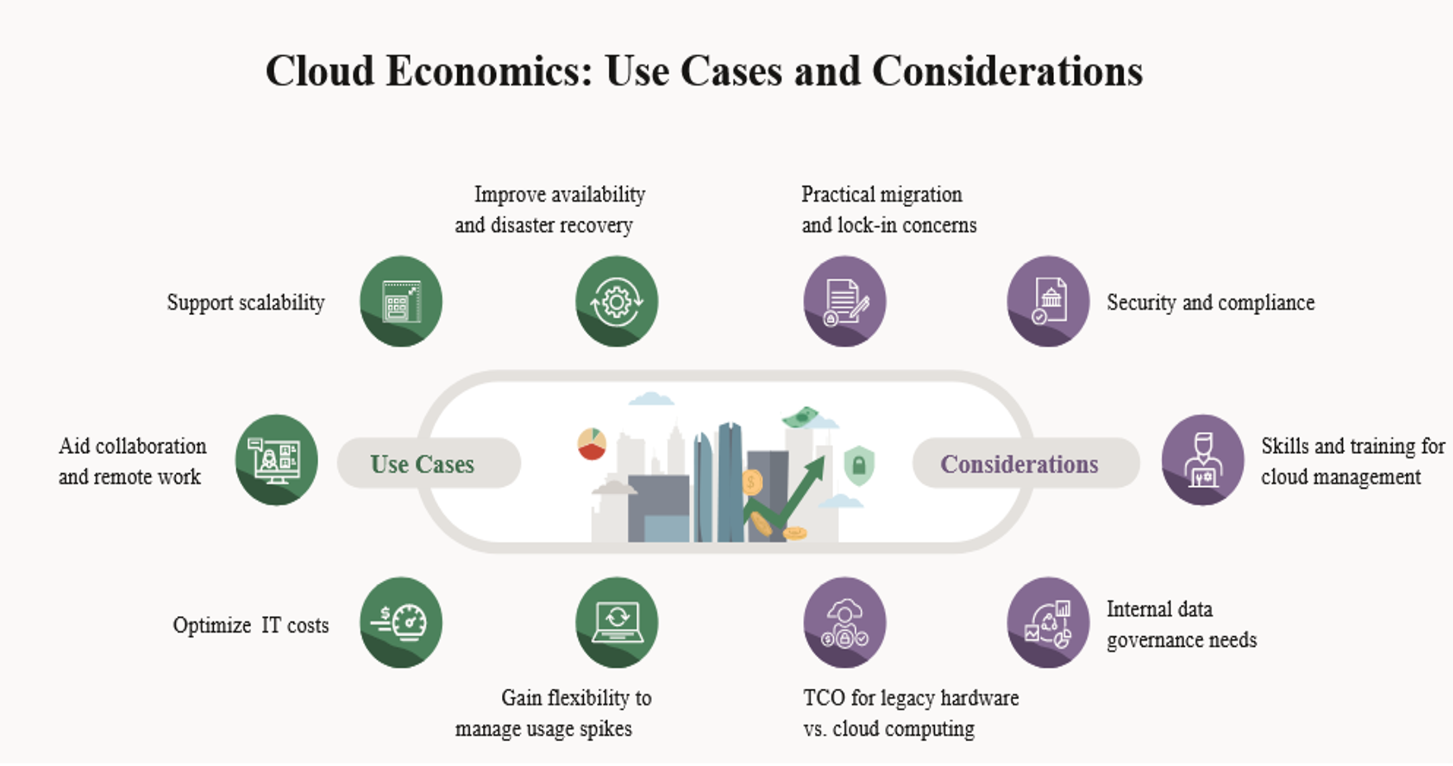
Cloud Use cases and considerations

Slide 9
Cloud economics
Cloud economics analysis should also consider:
Existing biases: Organizations must practice self-awareness to overcome human biases for an objective cloud economics evaluation
Risk/reward threshold: Knowing an organization's standard risk/reward approach—and when it can be adjusted—builds tolerances and boundaries for cloud economics calculations
Current processes: Will a shift to cloud computing impact processes that drive core business?
Notes:
Human nature makes us all prone to bias. Whether it’s staff locked into legacy applications or simple resistance to new technologies
Each organization’s comfort level with risk varies and depends on criteria such as culture, budget, and technical expertise. Knowing an organization's standard risk/reward approach—and when it can be adjusted—builds tolerances and boundaries for cloud economics calculations
In addition to expected financial and technology considerations, a cloud economics analysis should factor in the following cultural elements:
Current processes:
Will a shift to cloud computing impact processes that drive core business?
If so, will the change require new training and skills?
And will the involved teams have the bandwidth to absorb such a change?

Slide 10
Pillars cloud of economics approach
Total cost of ownership: TCO includes:
Infrastructure costs, such as the purchase or lease of the physical building, power and cooling systems, and networking.
Costs associated with hardware and software; personnel, including salaries and benefits for IT staff; maintenance and support, including software updates;
Energy (data centers require a substantial amount of power to operate).
Efficiency improvements: Efficiency improvements can vary in size and scope; e.g faster data sharing between sales and marketing teams, new IT innovations after freeing staff from data center responsibilities, and automatic data integration into applications such as self-service analytics.
Notes:
Cloud platforms provide organizational benefits, including improved collaboration and stronger DevOps support.

Slide 11
Pillars of cloud economics approach
Operational resilience: Local data centers are vulnerable to real-world issues such as natural disasters, power outages, and local political decisions, which can lead to unexpected downtime.
Operational agility: Many different factors can change the volume of network traffic, including app updates and remote access. To absorb these spikes, on-premises data centers need the physical resources to handle peak loads. In a cloud environment, scalability becomes as simple as upgrading to a higher service tier. This creates organizational agility, whether spikes are temporary, such as with holiday sales, or the start of significant and lasting growth
Notes:
Cloud platforms provide organizational benefits, including improved collaboration and stronger DevOps support.
Operational resilience: Local data centers face a constant risk of real-world issues affecting availability. Natural disasters, power outages, and even local politics regarding infrastructure can all cause unexpected downtime for on-premises equipment. Cloud providers build uptime guarantees into service level agreements and design their business models around redundancy, giving customers greater resilience.
Operational agility refers to an organization’s ability to quickly and effectively adapt to changes in its environment, operations, or market conditions

Slide 12
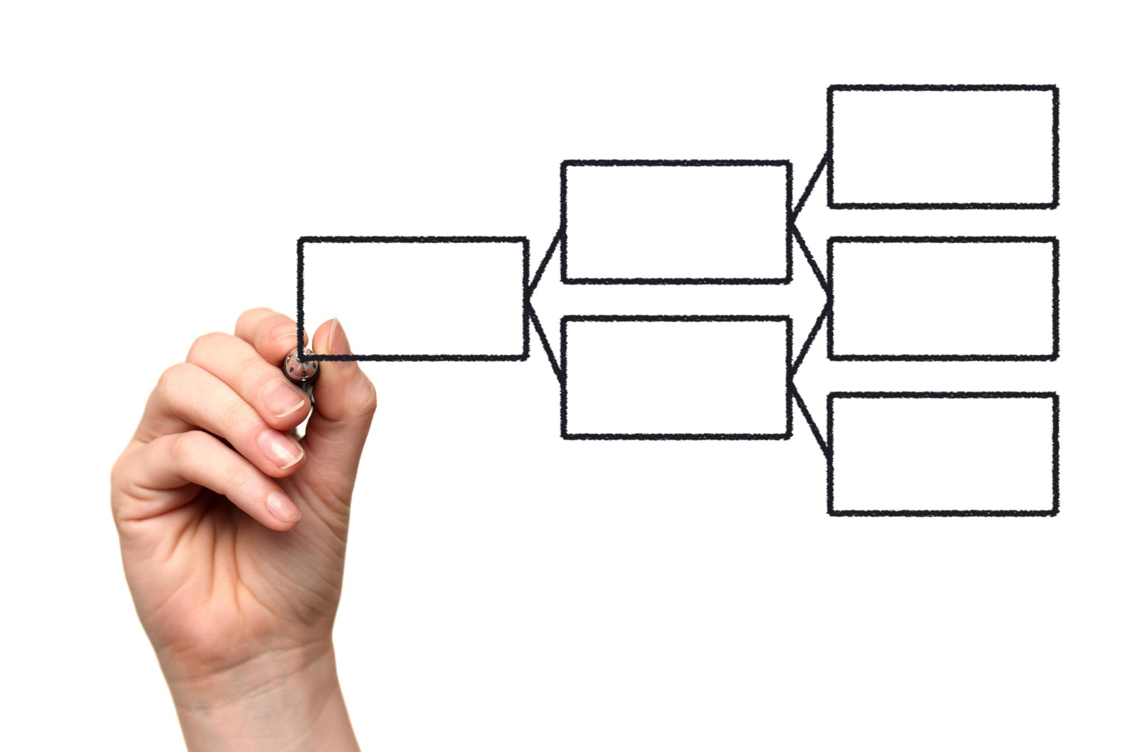
SWOT Analysis of Cloud Computing
Strengths include flexibility, scalability, and cost savings.
Weaknesses involve security concerns and dependency on providers.
Opportunities arise from emerging technologies and market growth.
Threats include increasing competition and regulatory challenges.
Notes:
A SWOT analysis of cloud computing highlights its strengths, such as flexibility and scalability, which make it attractive for businesses.
However, weaknesses like security risks and provider dependency must be managed.
Additionally, the rapid growth of cloud services presents opportunities,
while competitive pressures and regulatory issues pose potential threats. Competition among cloud providers can lead to price wars, which can either benefit or harm businesses depending on their provider.
Opportunities:
Growth in cloud adoption across industries, especially in AI, Big Data, and IoT.
New services, tools, and innovations in the cloud space (like edge computing and serverless architectures) offer cost-saving opportunities.

Slide 13

General Risks in Cloud Computing
Data security is a primary concern for cloud users.
Compliance with regulations can be complex and challenging.
Service outages can disrupt business operations.
Data loss risks exist due to accidental deletion or malicious attacks.
Notes:
General risks associated with cloud computing include data security, where breaches can lead to severe consequences. Compliance with various laws adds complexity, and service outages can greatly impact businesses. Additionally, risks of data loss through accidental deletions or attacks must be considered when relying on cloud services.

Slide 14

Cost Analysis of Cloud Computing
Understanding the total cost of ownership is crucial.
Cost structures can vary significantly among providers.
Hidden costs may arise from data transfer and storage fees.
Budgeting effectively requires careful monitoring of usage.
Notes:
When analyzing the costs of cloud computing, it's essential to understand the total cost of ownership, including all services used. Different providers offer varying cost structures, and users should be aware of potential hidden costs, such as data transfer fees. Ongoing monitoring of usage is necessary for effective budgeting.

Slide 15

Selecting an IaaS Provider
Evaluate provider reliability and uptime guarantees.
Examine the variety of services and features offered.
Consider the geographical location of data centers.
Review customer support options and response times.
Notes:
When selecting an Infrastructure as a Service (IaaS) provider, it's vital to evaluate the reliability and uptime guarantees of the service. A diverse range of services provided can enhance flexibility. The geographical location of data centers is important for compliance and performance, while robust customer support is essential for addressing issues quickly.

Slide 16
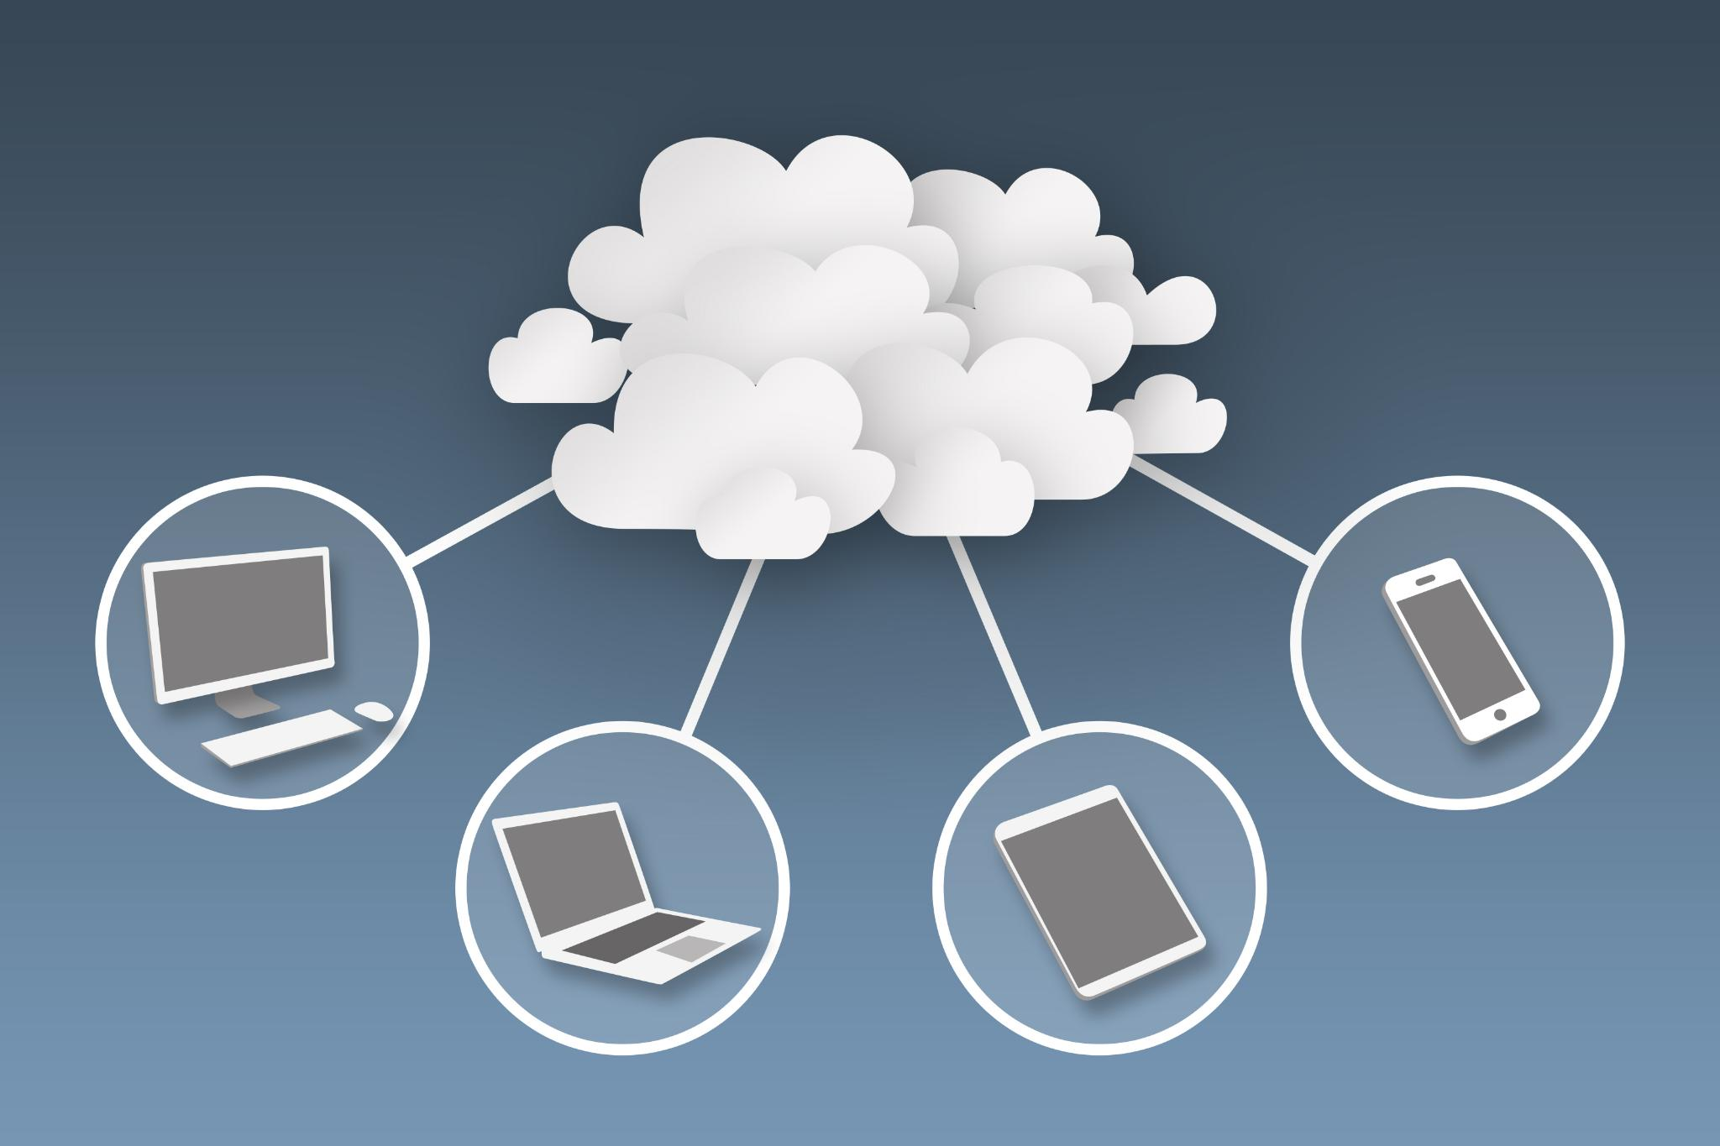
Cloud Standards and Interoperability
Standards promote compatibility among different cloud services.
Interoperability enhances flexibility and reduces vendor lock-in.
Adopting open standards can foster innovation.
Organizations must stay updated with evolving standards.
Notes:
Cloud standards play a crucial role in ensuring compatibility among various services, which facilitates interoperability.
This compatibility allows organizations to avoid vendor lock-in, enhancing their operational flexibility.
By adopting open standards, businesses can drive innovation, although they must remain vigilant about the evolving nature of these standards.

Slide 17

Successful Cloud Migration Recommendations
Develop a clear migration strategy and roadmap.
Identify and prioritize applications for migration.
Ensure comprehensive testing before full deployment.
Engage stakeholders throughout the migration process.
Notes:
To achieve a successful cloud migration, organizations should develop a clear strategy and roadmap that outlines the process.
Identifying and prioritizing applications for migration helps streamline efforts.
Comprehensive testing before full deployment mitigates risks, and engaging stakeholders throughout the process ensures buy-in and alignment with business goals.

Slide 18
Reasons for cloud economics
Cloud economics is important because:
A cloud migration affects both tangible budgets and theoretical shifts in operations and IT. No one-size-fits-all strategy applies.
For IT departments, cloud economics provides a deeper understanding of what organizations must prepare for in both the short and long term.

Slide 19
Making a Business Case for Cloud Economics
To make a sound business case for cloud economics, organizations should consider the questions:
What are our existing data center costs?
Organizations must evaluate their existing data center hardware, software, maintenance, and operational costs.
How difficult will migration be? The initial migration to the cloud will create a number of expenses unique to each organization.
What will monthly cloud costs be? Examine projected monthly costs based on a combination of historical usage and upcoming activity.
Notes:
To get approval for the cloud migration process, organizations must make a business case that addresses their specific needs.
A government office will have different needs than a small tech startup or an established corporation with legacy databases. A cloud environment will likely provide more flexibility while reducing costs in nearly any circumstance—but realizing the benefits depends on the execution.
To make a sound business case for cloud economics, organizations should consider the following questions:
What are our existing data center costs? To get started, organizations must evaluate their existing data center hardware, software, maintenance, and operational spend. Technical resources, licenses, regular repair and maintenance, and human labor costs all add up to a number that acts as a benchmark for a cloud economics analysis.
How difficult will migration be?
An organization that has an existing configuration with databases and internal networking is likely to have a more straightforward migration than a company that bases revenue on a larger customer base querying database records via an app.
Migration can be gradual, completed in stages, or done in one fell swoop with planned downtime and a backup strategy in place.
Organizations must project the one-time costs of migration, including time for testing apps on the new infrastructure.
Do you have a lot of custom or homegrown applications that will need to be moved to the cloud?
What will monthly cloud costs be? Once migration is complete, organizations can begin to examine projected monthly costs based on a combination of historical usage and upcoming activity. In addition to provider estimates for monthly fees, budget projections should include related costs such as management time, training, and governance.
How will this improve processes? If cloud migration will reduce monthly costs, then that offers a strong business case for transitioning. However, decision makers should look beyond the numbers to fully understand the scope of change. Enhanced collaboration, machine learning capabilities, improved processes, and increased levels of security are just the start. For developers and engineers, the cloud can accelerate rollouts while allowing for micro-updates rather than huge milestone releases. For operations teams, the cloud offers easier ways to unify and share data, allowing different groups to gain insights on demand. When making the business case for cloud economics, organizations must factor in the financial impact of these improvements as part of their long-term projections.

Slide 20
Cloud Economics Mistakes to Avoid
Assuming financials don’t evolve: By limiting the scope of cloud economics to immediate hardware benefits, organizations create inaccurate projections that skew the business case for the cloud while missing further opportunities.
Basing projections on historical usage: Organizations that rely only on historical usage patterns may find themselves unprepared to handle a spike in activity.
Treating all cloud elements the same: Each organization holds different priorities for compute, storage, and other infrastructure elements. IT teams should identify their priorities.
Putting all data in the cloud: Some applications won’t benefit from being in the cloud.
Notes:
While it’s true that a cloud migration delivers many benefits, the nuances of cloud economics require forethought, smart decision-making, and continual monitoring.
Otherwise, common mistakes can occur, including the following:
Assuming financials don’t evolve:
The savings accrued during the first week, month, or even year don’t necessarily reflect longer-term financial projections.
Big-picture cloud economics takes many different variables into account, including accelerated development time and new cloud-based features.
Basing projections on historical usage:
Cloud budgeting is based on a pay-as-you-go model, but organizations that rely only on historical usage patterns may find themselves unprepared to handle a spike in activity.
Historical usage should be only one of the data points considered in projecting budgets. Seasonality, the frequency of releases and upgrades, publicity and marketing campaigns, and other factors also require consideration for proper cloud resource planning.
While it’s true that a cloud migration delivers many benefits, the nuances of cloud economics require forethought, smart decision-making, and continual monitoring. Otherwise, common mistakes can occur, including the following:
Treating all cloud elements the same:
Compute, storage, and other infrastructure elements will likely hold different priorities for each organization. IT teams should identify their priorities and the scope of their resources to understand which elements benefit most from the scalability and elasticity of a cloud environment.
Putting all data in the cloud: Some applications won’t benefit from being in the cloud. In these situations, migrating the app creates additional work and costs when it might be simpler and more cost-effective to keep the status quo. Organizations should evaluate all their potential workloads to identify any that can, and should, remain as is for cost and resource efficiency.

Slide 21
Pricing Strategies
Tiered Pricing: Cloud Services are offered in the various tiers. Each tier offers to fix service agreements at a specific cost. Amazon EC2 uses this kind of pricing.
Per-unit Pricing: The model is based upon the unit-specific service concept such as RAM/hour. Data transfer and memory allocation include in this model for specific units.
Subscription-based Pricing: In this model, users are paying periodic subscription fees for the usage of the software.
Notes:
There are three different Pricing Strategies that are introduced by Cloud Computing: Tiered Pricing, Per-unit Pricing, and Subscription-based Pricing.

Slide 22
Getting value for money
Don’t pay for more than you need, don’t get less than what you have paid for.
It is difficult to predict exactly the right resources that are available at exactly the right time when needed. Sometimes there are factors like delay, whose cost might be difficult to compute.
Often demand and resources are measured in separate units—for example, the demand is for sweaters, and the resources needed are knitting machines operators, and wool.
Notes:
Under normal conditions, we don’t have to pay for more than what we need and at the same time we do not want to receive less than what we paid for.

Slide 23
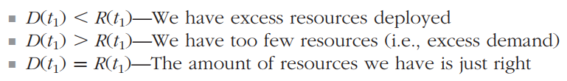

Getting value for money
Assume that the demand for resources over time is a function, D(t), and the resources available to meet that demand is also a function, R(t). At any given time, say, $t_{1}$, one of these must hold:
When $D\left(t\right)=R(t)$ , we have perfect capacity.
Notes:
In the best of all worlds, at all times we would have exactly the correct amount of resources to satisfy demand or D(t) =R(t). We can call this perfect capacity. In attempting to match resources to capacity, there are six major areas to consider.

Slide 24
Getting value for money
Matching Capacity and Resources: Areas to consider:
Frequency of demand assessment. Are we checking the level of demand only once a week, or continuously?
Accuracy of this assessment. How good is our process for evaluating demand?
Underlying variability and unpredictability of the demand curve. Is it flat, linearly growing, random but distributed normally, or something else?
Accuracy of the forecasting process. Being able to exactly forecast demand a month from now gives us provisioning advantages.

Slide 25
Getting value for money
Matching Capacity and Resources: Key Considerations:
Response time for capacity adjustments. If we can quickly identify a change in demand but take a long time to respond, it could create issues. This response time can be consistent (e.g., nine months), variable (e.g., two to five months), nearly immediate, or somewhere in between.
Adjustment granularity. If demand fluctuates in tens or hundreds of watts, but capacity is only available in kilowatt or megawatt increments, this mismatch can be problematic.

Slide 26
CASE STUDY
Background
OptiSoft Uganda Ltd. is a mid-sized software development company that builds custom enterprise applications for businesses in Uganda. The company has been running its IT infrastructure on-premises, managing its own servers, networking equipment, and storage. However, due to increasing demand for its software solutions and the need for faster deployment, OptiSoft Uganda is considering migrating to the cloud.
Current IT Infrastructure and Challenges
OptiSoft Uganda’s on-premise infrastructure consists of:
10 physical servers, each costing UGX 20,000,000, with a lifespan of 5 years.
Annual maintenance costs of UGX 80,000,000 for hardware repairs and system upgrades.
IT staff costs of UGX 400,000,000 per year for managing and maintaining infrastructure.
Limited scalability, leading to slow deployment times for new projects.
Disaster recovery concerns, as all data is stored in a single data center, making it vulnerable to outages.

Slide 27
CASE STUDY
Discussion
OptiSoft Uganda is considering moving to a cloud-based Infrastructure-as-a-Service (IaaS) solution from one of the major cloud providers (AWS, Azure, or Google Cloud). The cloud provider offers:
Pay-as-you-go pricing, with computing costs at UGX 370 per CPU hour and storage at UGX 74 per GB per month.
Elastic scalability, allowing the company to scale up and down based on demand.
Built-in disaster recovery with data redundancy across multiple geographic locations.
OptiSoft Uganda has contracted your group to assess the merit of its proposal to move to the cloud-based IaaS.
Your group should present arguments on cost, security, performance, scalability and perform a SWOT analysis.
Notes:
Case Study Reflection Questions
What are the key cost drivers in cloud computing?
How does scalability impact economic decisions in cloud adoption?
What strategies can OptiSoft Uganda use to minimize cloud expenses?
What are the hidden costs of cloud migration that OptiSoft Uganda should consider?

Slide 28
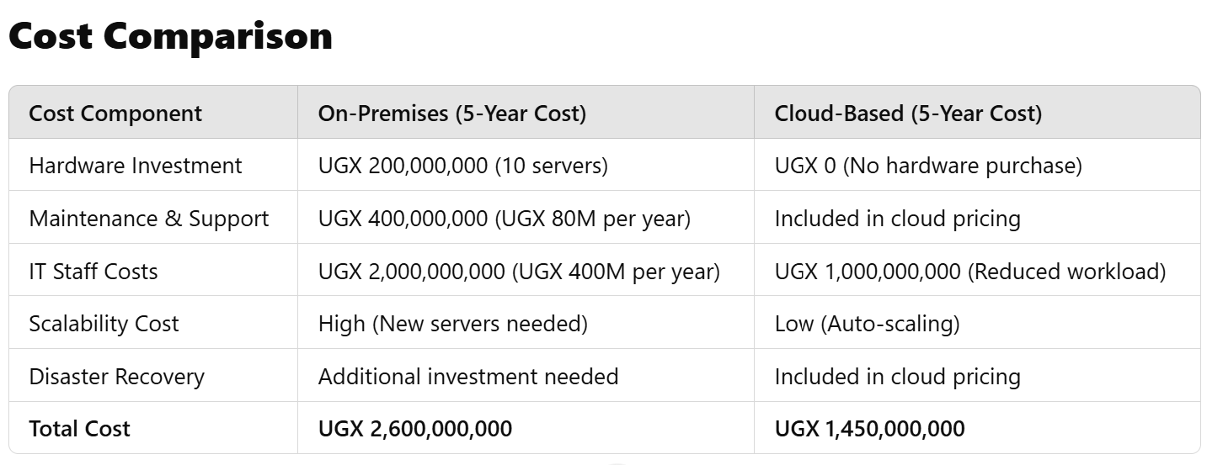
CASE STUDY
Notes:
Decision Point
Before making the final decision, OptiSoft Uganda’s leadership team wants to analyze the economic impact of moving to the cloud. The company is concerned about:
Cost savings vs. long-term expenses: Is pay-as-you-go truly more economical than owning infrastructure?
Vendor lock-in: If they commit to one cloud provider, will it be difficult and costly to switch later?
Security risks: Can the cloud provider guarantee the same level of security as an on-premise setup?
Performance concerns: Will cloud latency impact software deployment and performance?
Case Study Reflection Questions
What are the key cost drivers in cloud computing?
How does scalability impact economic decisions in cloud adoption?
What strategies can OptiSoft Uganda use to minimize cloud expenses?
What are the hidden costs of cloud migration that OptiSoft Uganda should consider?

Slide 29
Conclusion
Pillars of Cloud Valuing
- TCO
- Efficiency
- Resilience
- Agility
Pricing Strategies
- Tiered Pricing
- Per-unit Pricing
- Subscription-based Pricing
Cloud Economics Pitfalls
- Assuming financials don’t
evolve
- Basing projections on historical
usage
- Treating all cloud elements the
same
- Putting all data in the cloud
Notes:
TCO: Savings from reducing hardware and overhead expenses and changing to a pay-as-you-go model.
Efficiency: Accelerated development, increased collaboration, and other operational benefits that improve an organization’s efficiency over the long term.
Resilience: A stronger operational experience due to better network performance, improved disaster recovery, and higher and more stable availability.
Agility: The ability to launch with micro-updates, scale as needed, and shorten the development cycle, all leading to better business opportunities.
Which cloud model is most economical?
Cloud providers typically offer public and private models. Between these two, public is the easiest to implement, both in terms of functionality and cost. Private clouds require more management and initial setup. However, organizations can use hybrid models to connect public and private systems. The economics of hybrid clouds vary and often fall somewhere in between the public and private cloud in terms of cost.

Slide 30
References
https://www.oracle.com/cloud/cloud-economics-explained/
Book: Cloudonomics: The Business Value of Cloud Computing by Weinman, Joe.

